Slide 1
Network Security & Threats

Slide 2
WHAT IS PERIMETER SECURITY?
A perimeter is the fortified boundary of the network that might include the following aspects:
Border routers
Firewalls
IDSs
IPSs
VPN devices
Software architecture
DMZs and screened subnets

Slide 3
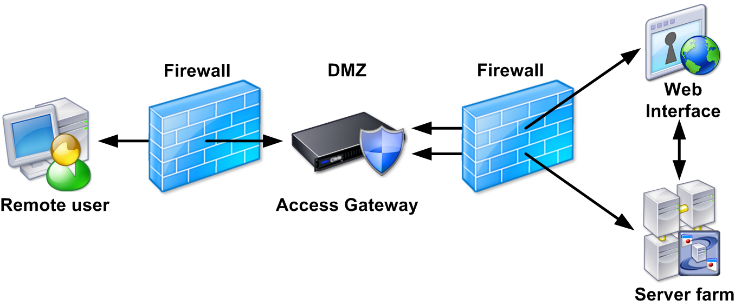
WHAT IS GATEWAY SECURITY?
Either through misconfiguration, or a complete lack of firewalling capability, networks around the world are wide open to attack.
Gateway security deals with architecting and configuring the gateway to enforce a strong security policy at a single point in order to protect wired and wireless resources in the network.
A gateway is the first line of defense from an attacker who has complete physical and logical access.

Slide 4

WHAT IS MONITORING?
Network monitoring involves attempting to detect attacks on a network, or on hosts on the network, by monitoring the network traffic.
This is usually done at the firewall or filtering router, so that all traffic coming into the network can be analyzed.
Network monitoring involves collecting statistics on usage to determine things that provide a measure of the health of the network.
It can also include characterizing the kind of traffic on the network as either “normal” or “abnormal”.

Slide 5
WHAT IS SIEM?
Security Information and Event Management (SIEM) solutions are a combination of the formerly disparate products categories of SEM (Security Event Manager) and SIM (Security Information Manager).
SIEM technology provides real-time analysis of security alerts generated by network hardware and applications.
SIEM solutions come as software, appliances, or managed services.
The key focus is to monitor and help manage user and service privileges, directory services, and other system configuration changes, as well as providing log auditing, review, and incident response.
1 of 3

Slide 6
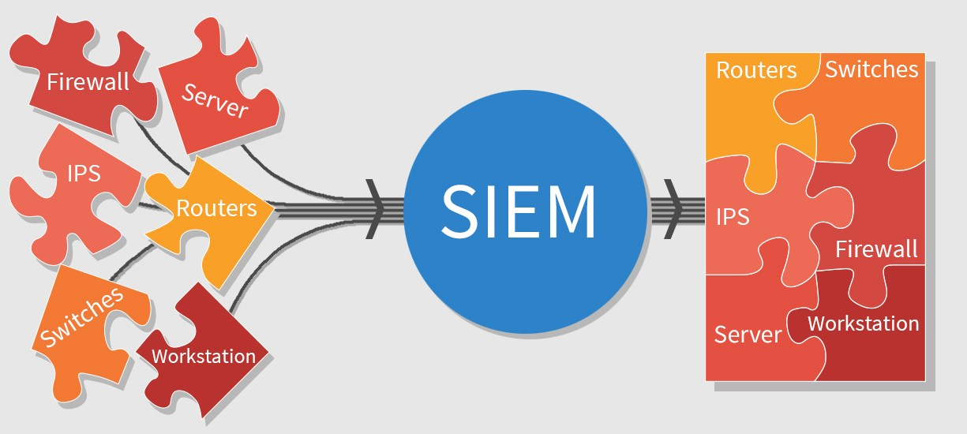
WHAT IS SIEM?
The term SIEM describes the product capabilities of gathering, analyzing, and presenting information from network and security devices; identity and access management applications; vulnerability management and policy compliance tools; operating system, database and application logs; and external threat data.
2 of 3

Slide 7
WHAT IS SIEM?
Features of SIEM
Data aggregation
Log management
Correlation
Alerting
Dashboards
Compliance
Retention
3 of 3

Slide 8
WHAT IS INCIDENT RESPONSE?
Security Incident Response involves the monitoring and detection of security events on a computer or computer network, and the execution of proper responses to those events.
Computer security incident response is a specialized form of incident management, the primary purpose of which is the development of a well understood and predictable response to damaging events and computer intrusions.
The purpose of security incident response is to bring needed resource together in an organized manner to deal with an advert event (incident) that is related to the safety and security of the information system.
1 of 3

Slide 9
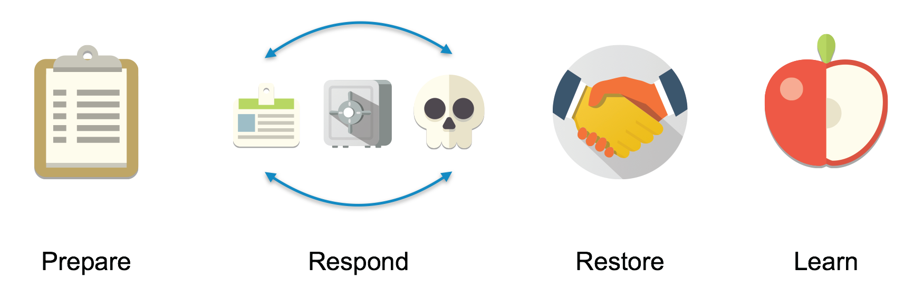
WHAT IS INCIDENT RESPONSE?
Phases of Security Incident Response
2 of 3

Slide 10
WHAT IS INCIDENT RESPONSE?
Objectives of Security Incident Response Activities
Limit the immediate incident impact
Securing the data
Recover from the incident
Determining the root cause by performing a detailed evaluation and analysis
Find out how to avoid further exploitation of the same vulnerability
Containment of the incident
Assess the financial impact, loss of data, data breaches, reputation
Update corporate security policies as necessary
3 of 3

Slide 11
WHAT IS SUPPORT?
Network support focusses on the maintenance of an existing corporate network, either as a part of the organization’s internal IT support team or as technical support staff of a third-party network technology provider.
Network support includes following up on interrupt-driven tasks, such as:
Troubleshooting devices and link failures
Responding to users experiencing network problems
Replacing equipment
Restoring Backups
1 of 2

Slide 12
WHAT IS SUPPORT?
Security Analysts are responsible for providing Level 2 support of security incidents as they occur.
Senior security analysts provide Level 3 support for security operations by identifying the root causes of the incident and providing solutions to remediate it.
Roles and responsibilities of Security Analysts are:
Monitoring security access
Conducting security assessments
Performing both internal and external security audits
Analyzing security breaches to identify the root cause
2 of 2

Slide 13

WHAT IS BACKUP PROCESS?
Having data backup is the cornerstone of any disaster recovery plan.
Without backups, a simple hard drive failure can set your company back days or even weeks. In fact, without backups, your company’s very existence is in jeopardy.
The main goal of backups is simple: Keep a spare copy of your network’s critical data so that, no matter what happens, you never lose more than one day’s work.
The easiest way to do this is to make a copy of files every day. If that’s not possible, techniques are available to ensure that every file on the network has a backup copy that’s no more than a day old.
1 of 3

Slide 14
WHAT IS BACKUP PROCESS?
Backup Strategy
Backup Definition and Scheduling
Backup Execution and Verification
Backup Monitoring
Consistency Check
2 of 3

Slide 15
WHAT IS BACKUP PROCESS?
There are five different types of backups that can be performed:
Normal (Full) Backup
Copy Backup
Daily Backup
Incremental Backup
Differential Backup
An archive bit is used by the backup program before and after taking the backup, in order to differentiate among the different backups types.
The archive bit indicates whether a file has been modified since the last time it was backed up.
3 of 3

Slide 16

WHAT IS DISASTER RECOVERY?
Disaster recovery involves the processes, policies, and procedures necessary for the recovery of operations and the continuation of the critical functions of an organization after a disaster.
Disaster recovery is important to organizations as it returns them to normal operating conditions, limits the effects of the disaster on business functions, and minimizes occurrences of certain types of disasters in the future.
1 of 2

Slide 17
WHAT IS DISASTER RECOVERY?
Disaster recovery is important due to existence issues such as:
Physical Violence
Hacking Attempts
Computer Malware
Rising Incidents of Information Security Emergencies
Machine or Hardware Fail
Human Mistakes
Natural Calamities
2 of 2

